Slide 1
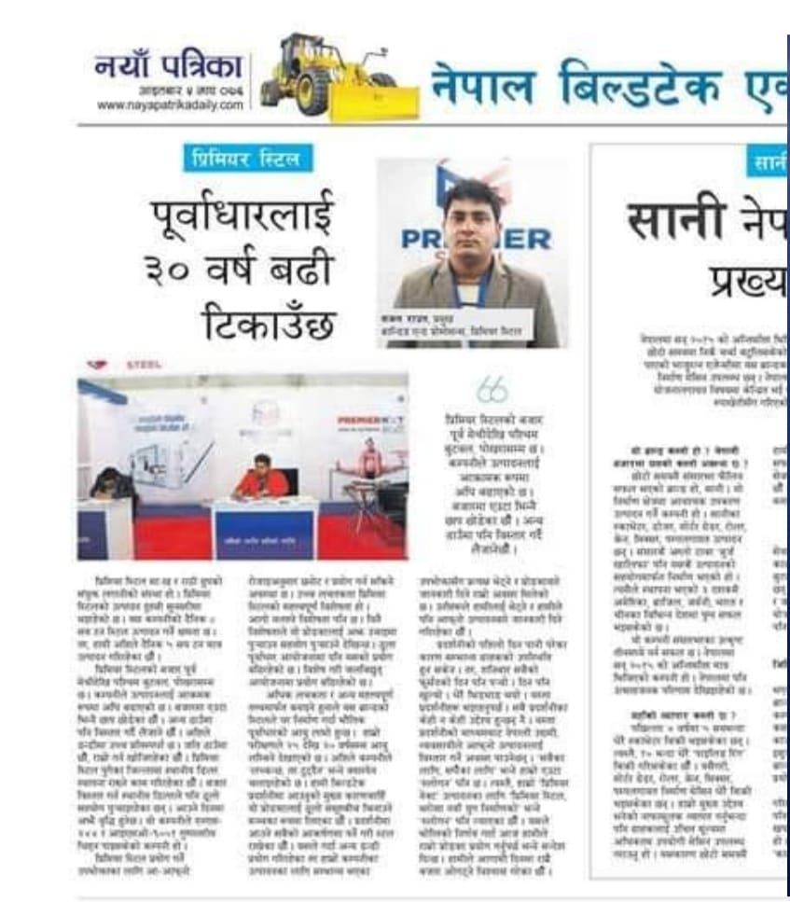
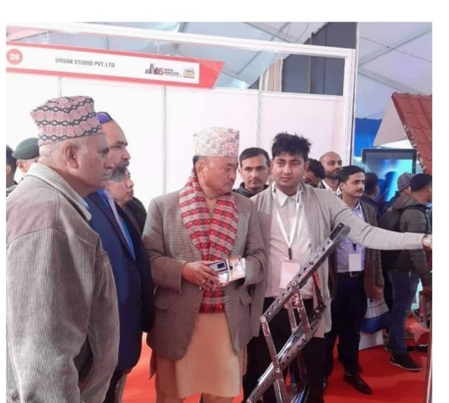
INTERVIEW/ EXPLAINING
INETRVIEW IN NAYAPATRIKA-2076
EXPLAINING MINISTER

Slide 2
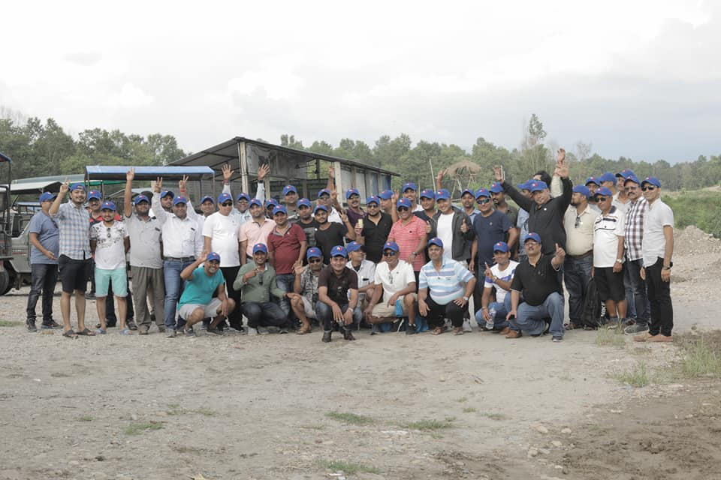
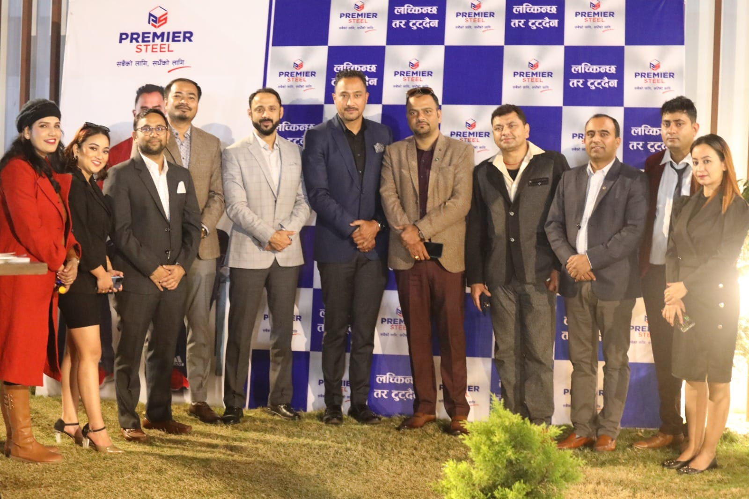
DEALER MEET
2076
2080

Slide 3
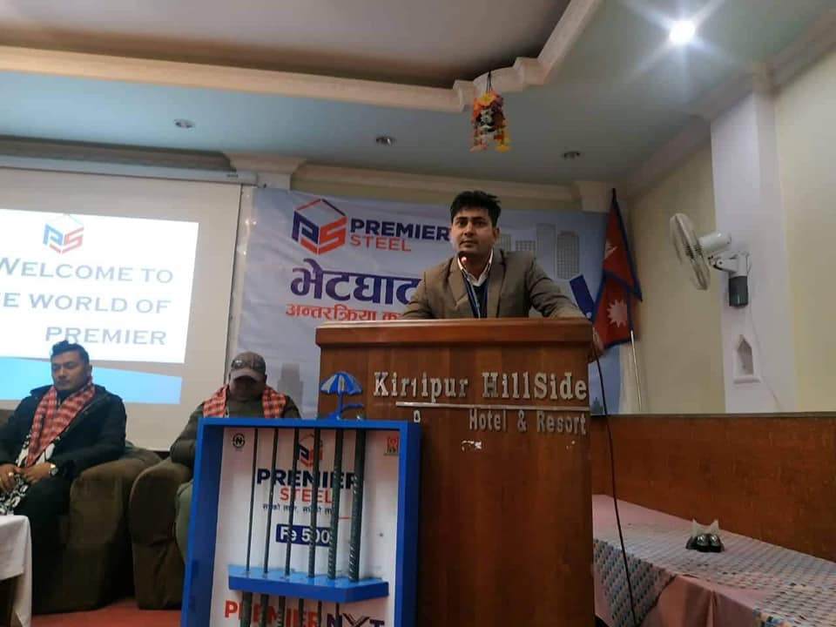
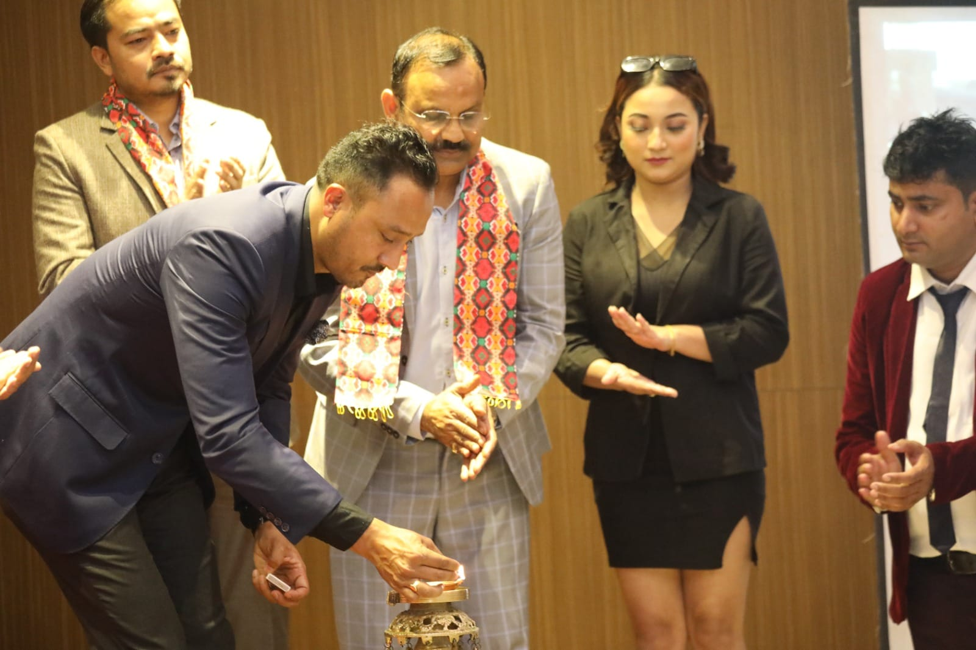
DEALER MEET
2078 KIRTIPUR SUB- DEALER MEET
PANAS DIYO/ DEALER MEET 2080

Slide 4
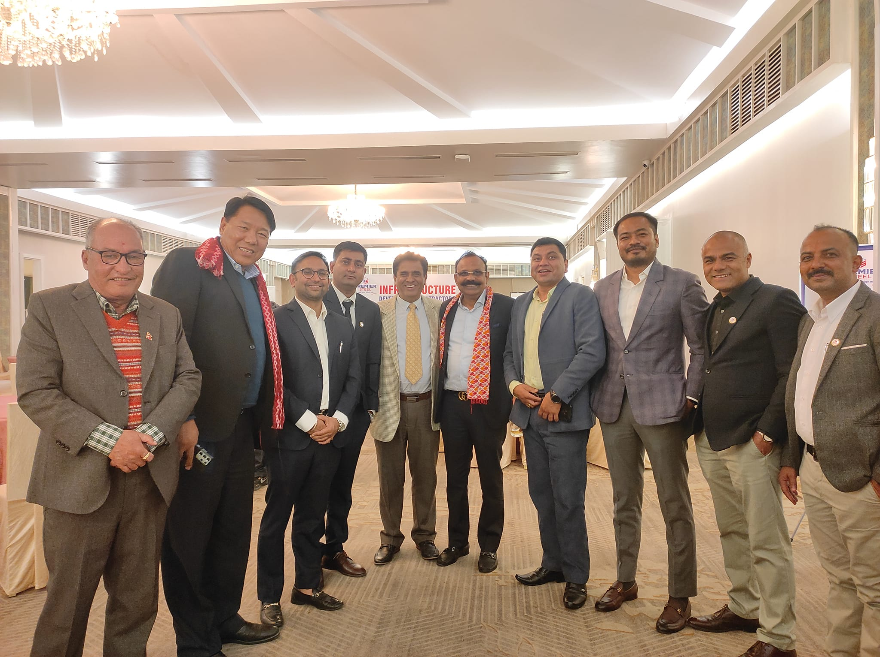
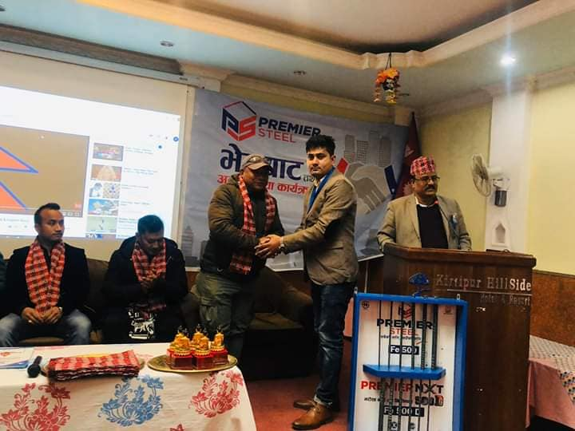
CONTRACTOR MEET/ SUB DEALER MEET
CONTRACTOR MEET- KTM
SUB-DEALER MEET KIRTIPUR

Slide 5
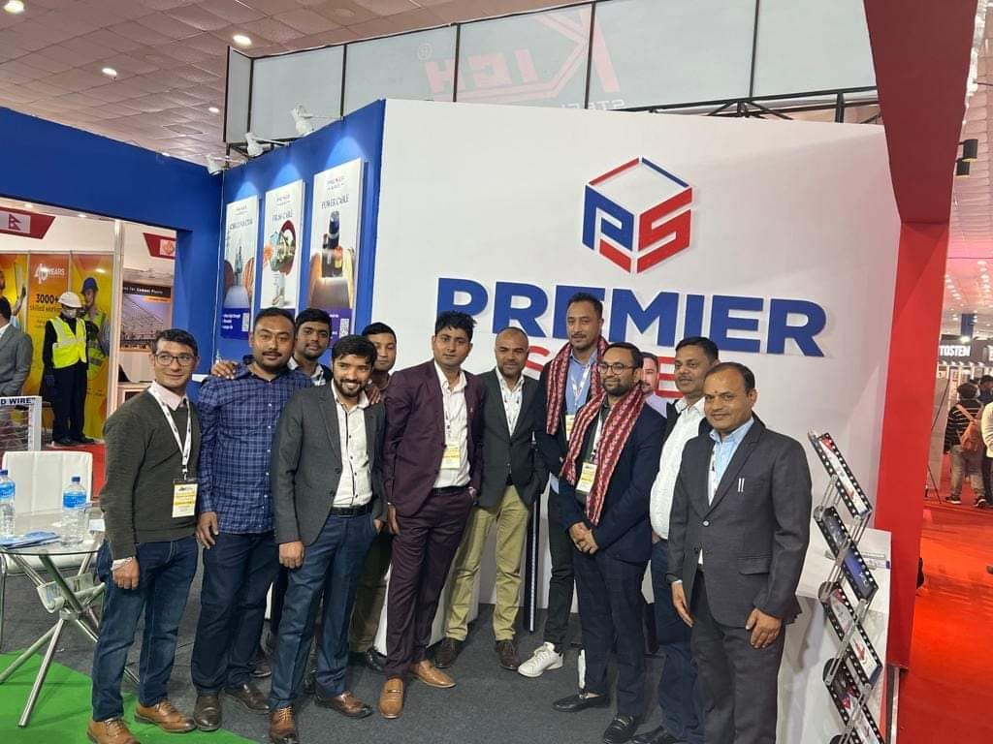
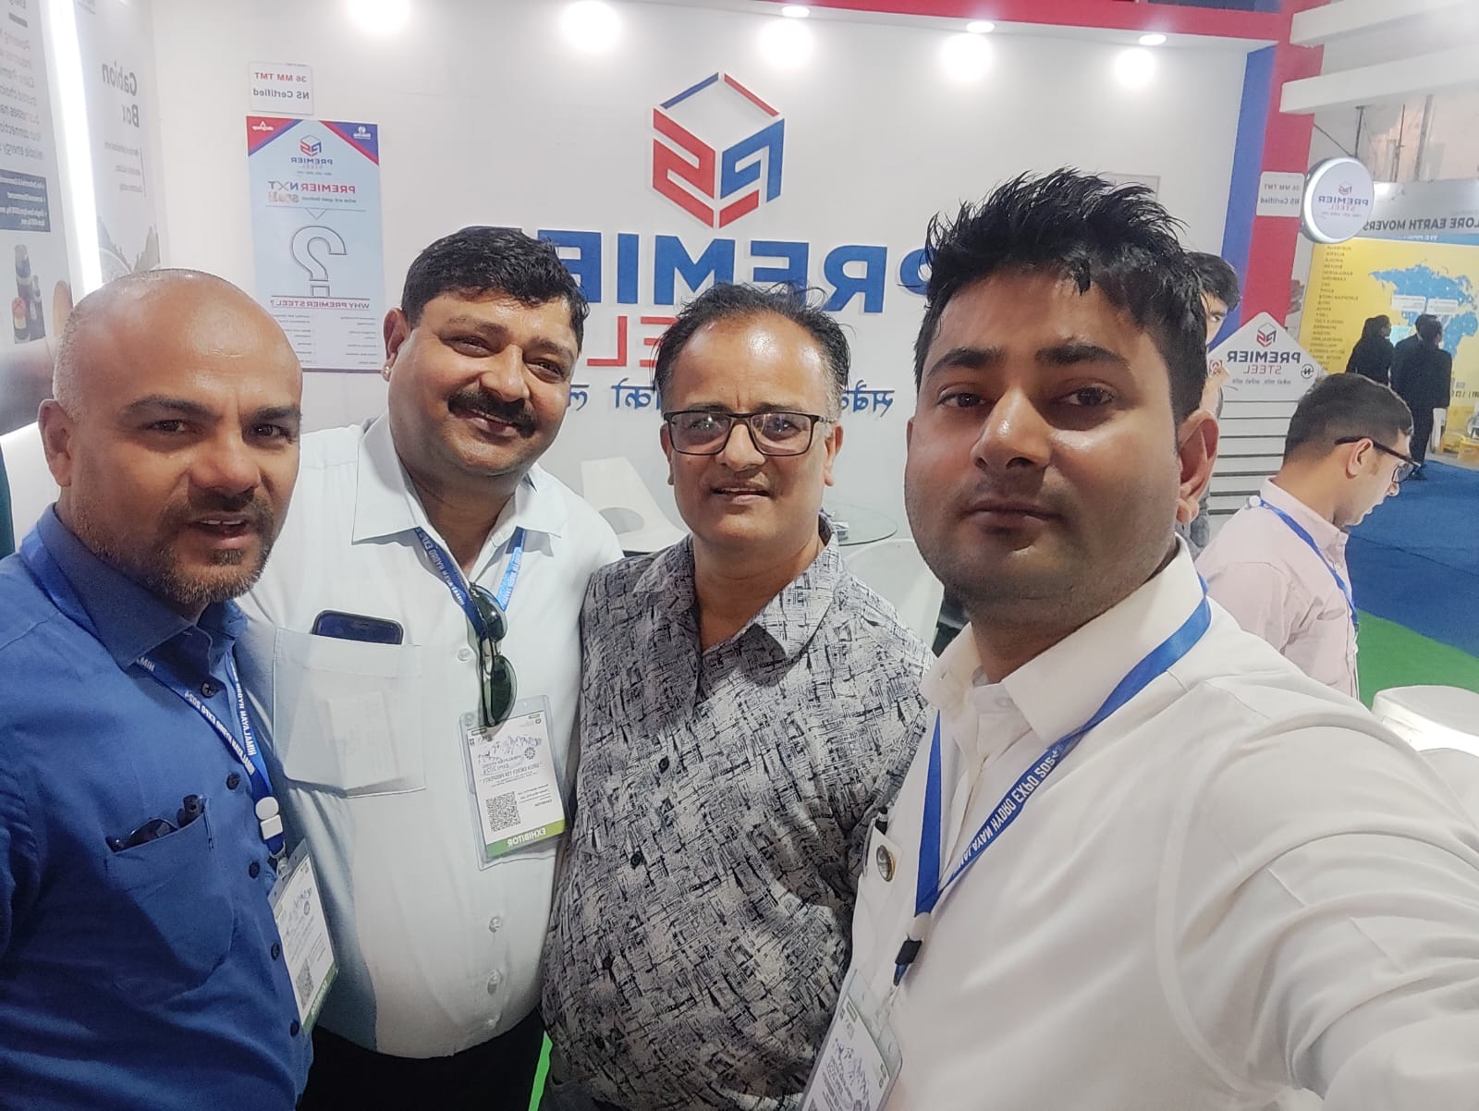
EXHIBITION
2080
2081

Slide 6
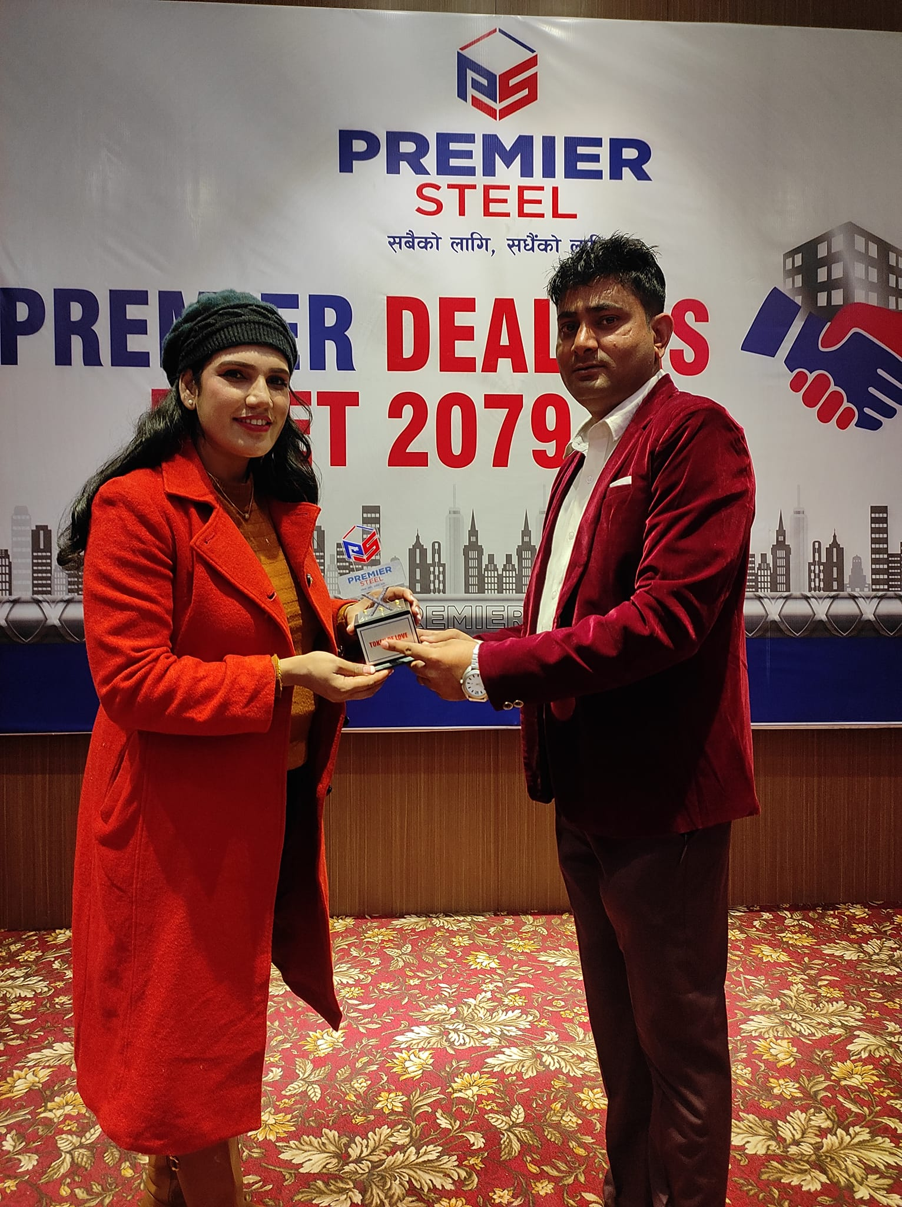
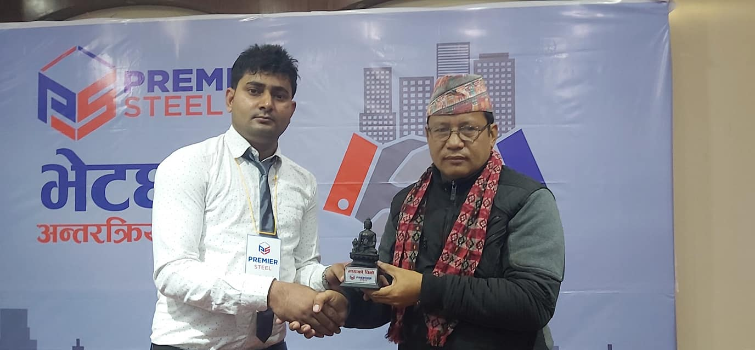
GIFT DISTRIBUTION
TOKEN OF LOVE – MASON ADHYASH
TOKEN OF LOVE DISTRIBUTION – DEALER MEET

Slide 7
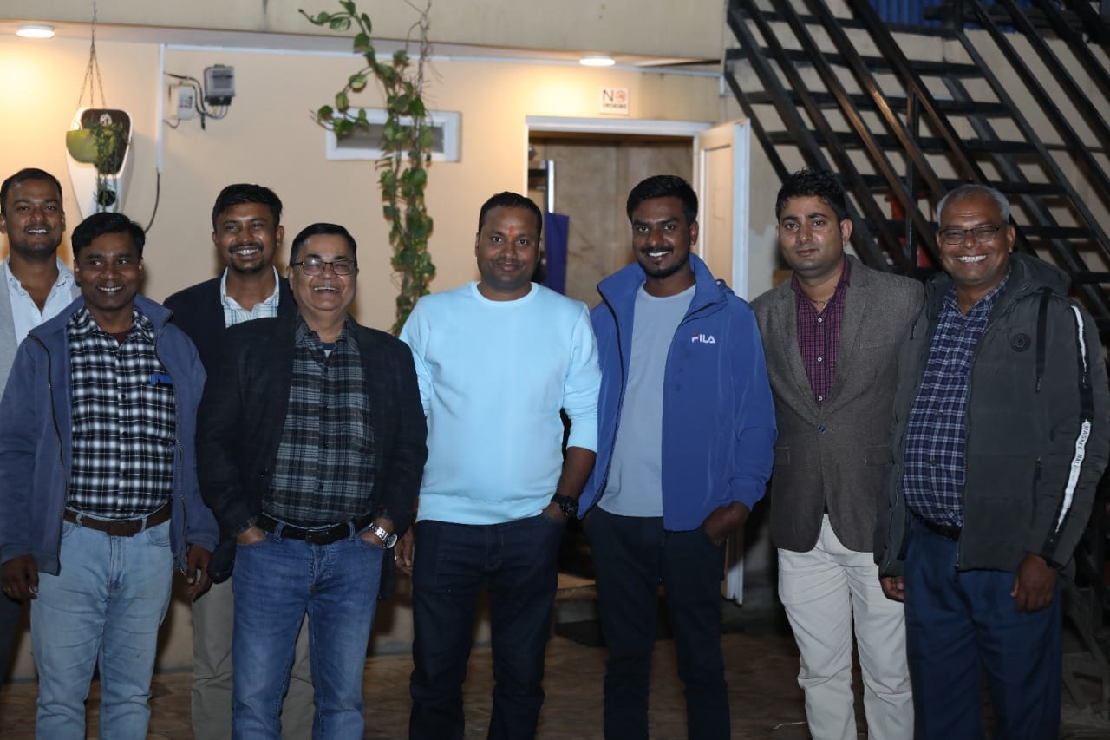
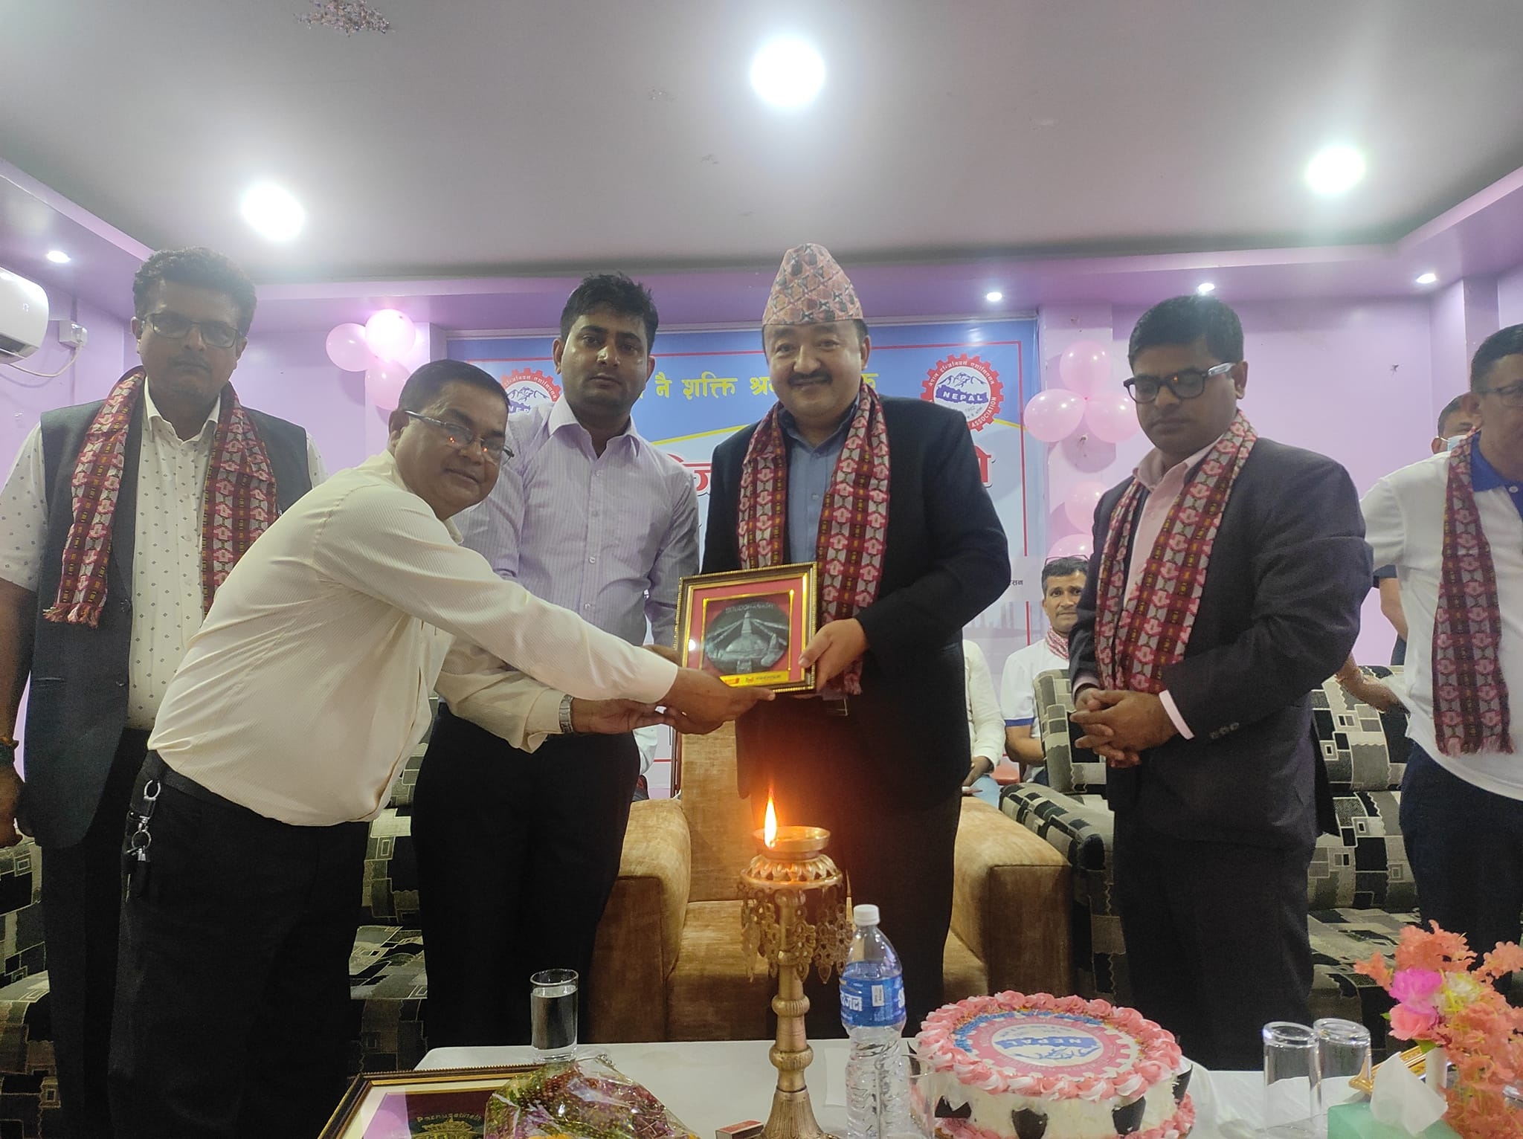
PROGRAM-2079
SITE INNAGUARATION- DHALKEWAR
ENGINEER’S MEET-2079 BIRATNAGAR

Slide 8
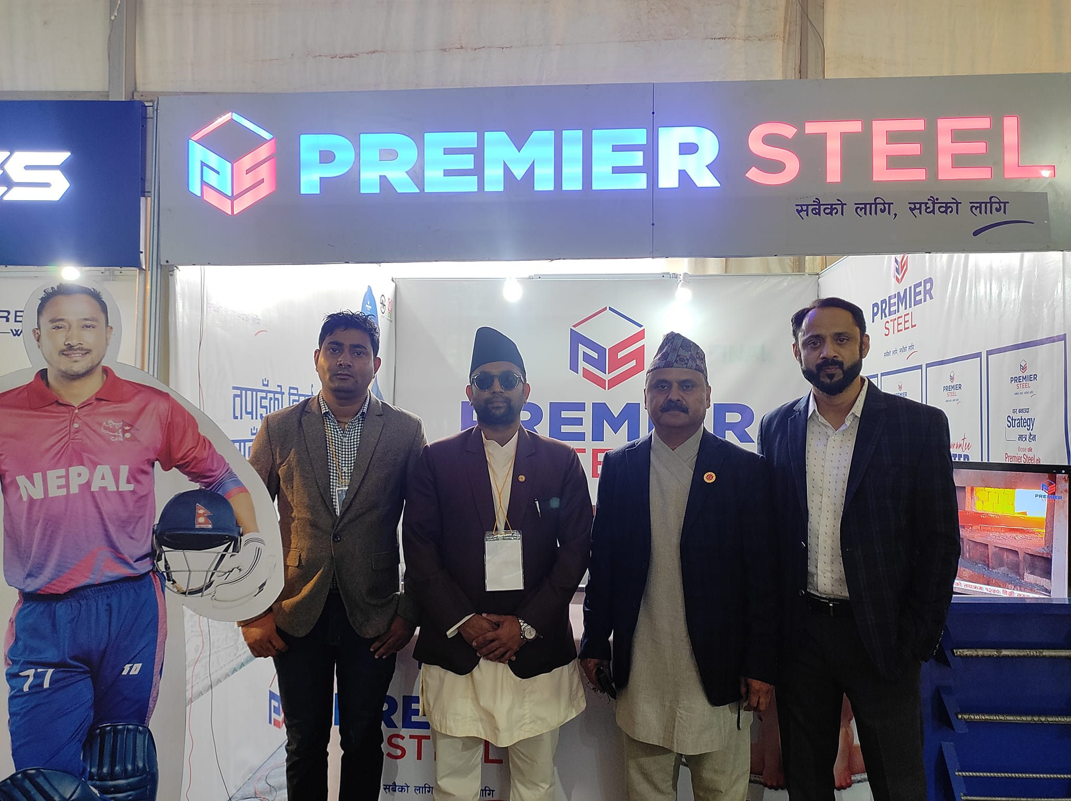
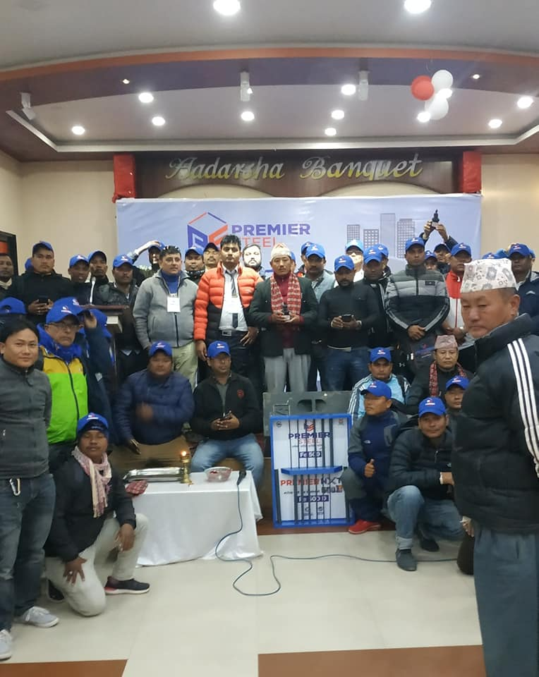
EXPO
BIRATNAGAR EXPO 2079
BIRTAMOD MASON MEET 2076

Slide 9
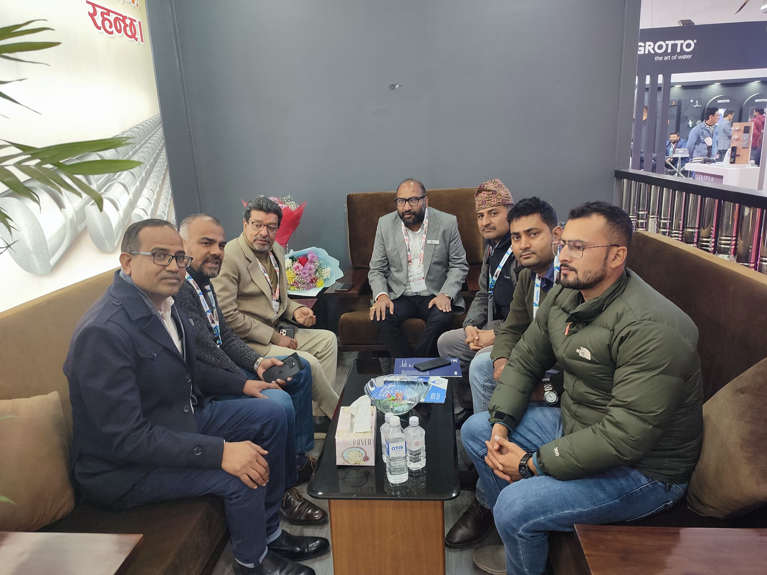
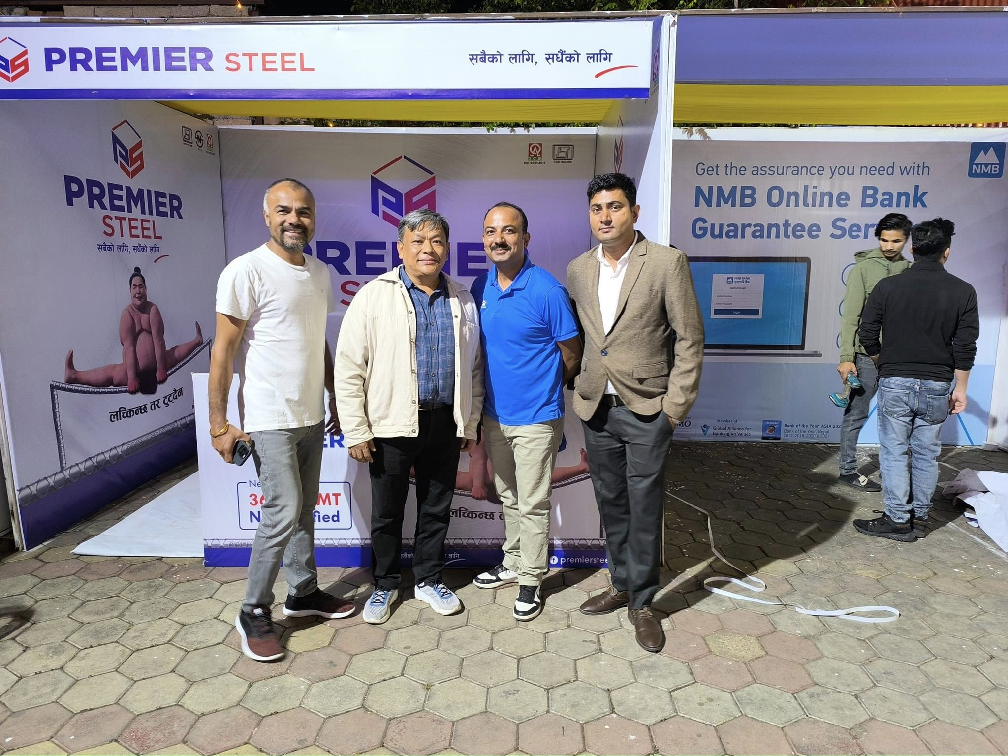
EXHIBITION-2080
BUILDCON
FCAN AGM EXPO HETAUDA 2080

Slide 10
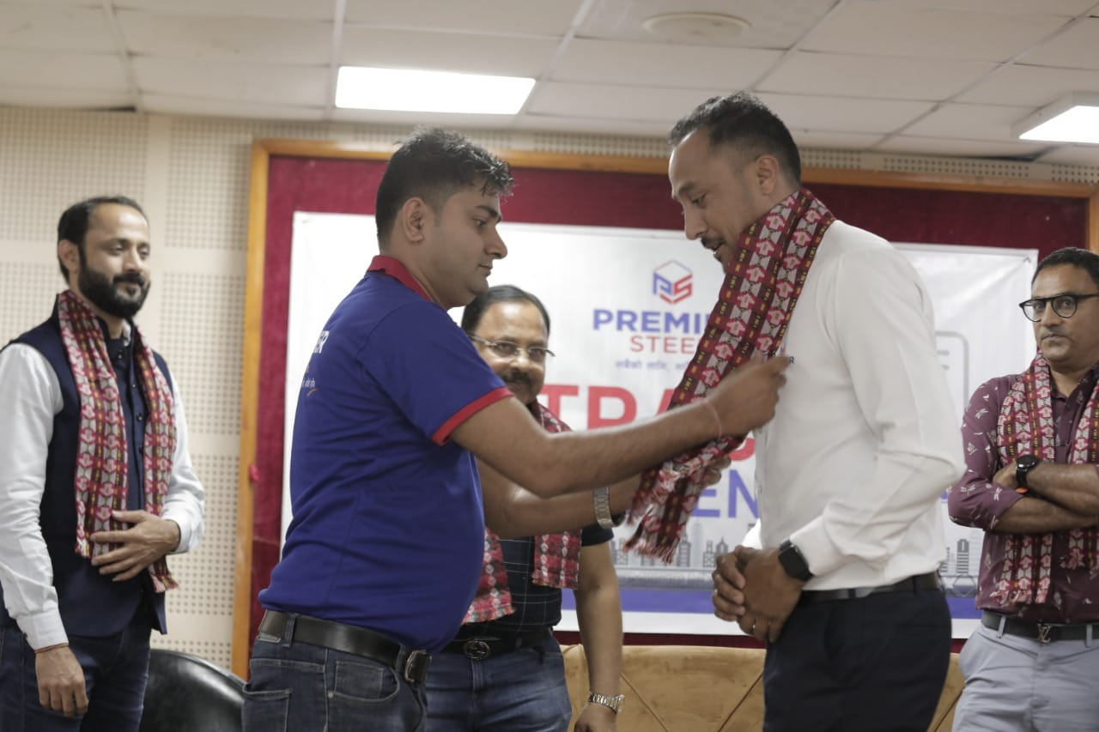
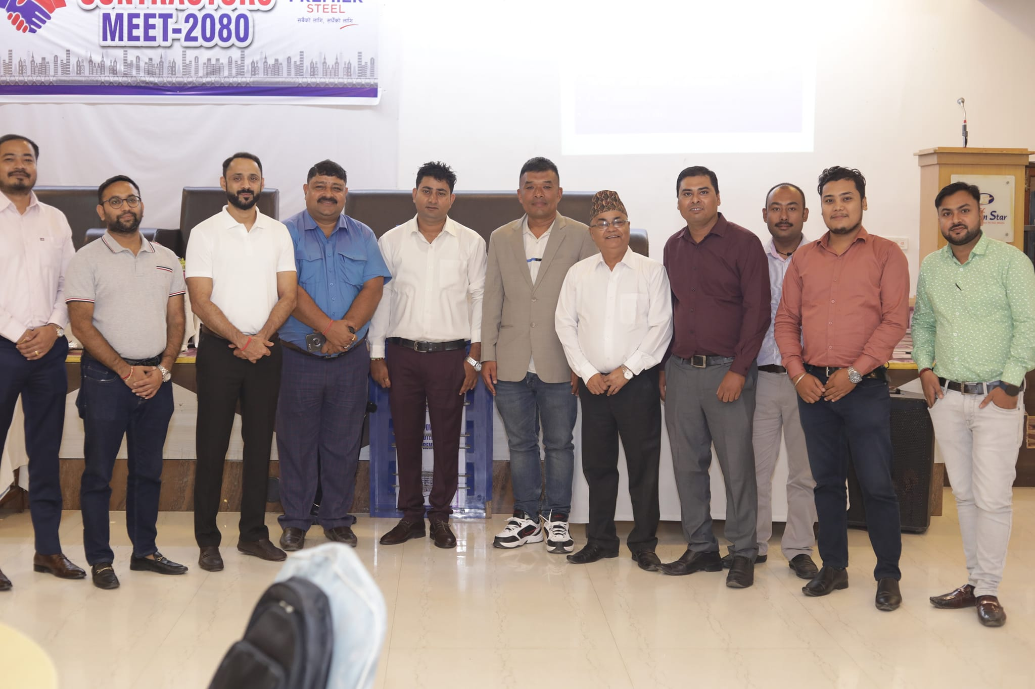
PREMIER STEEL PROGRAM
CONTRACT SIGNING AGREEMENT-BRT
CONTRACTOR MEET- 2080 BIRATNAGAR

Slide 11
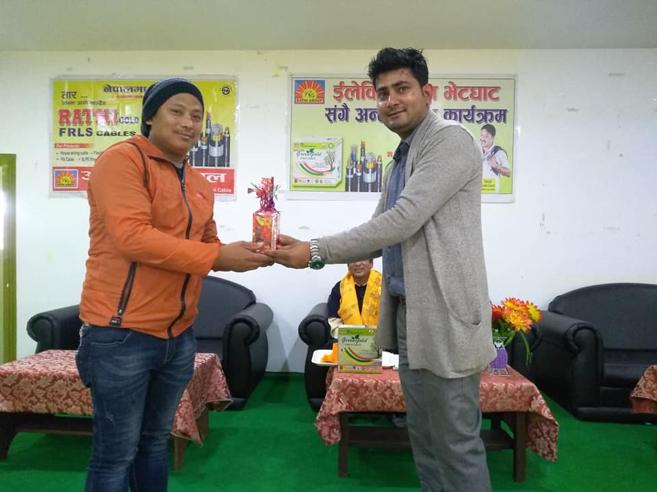
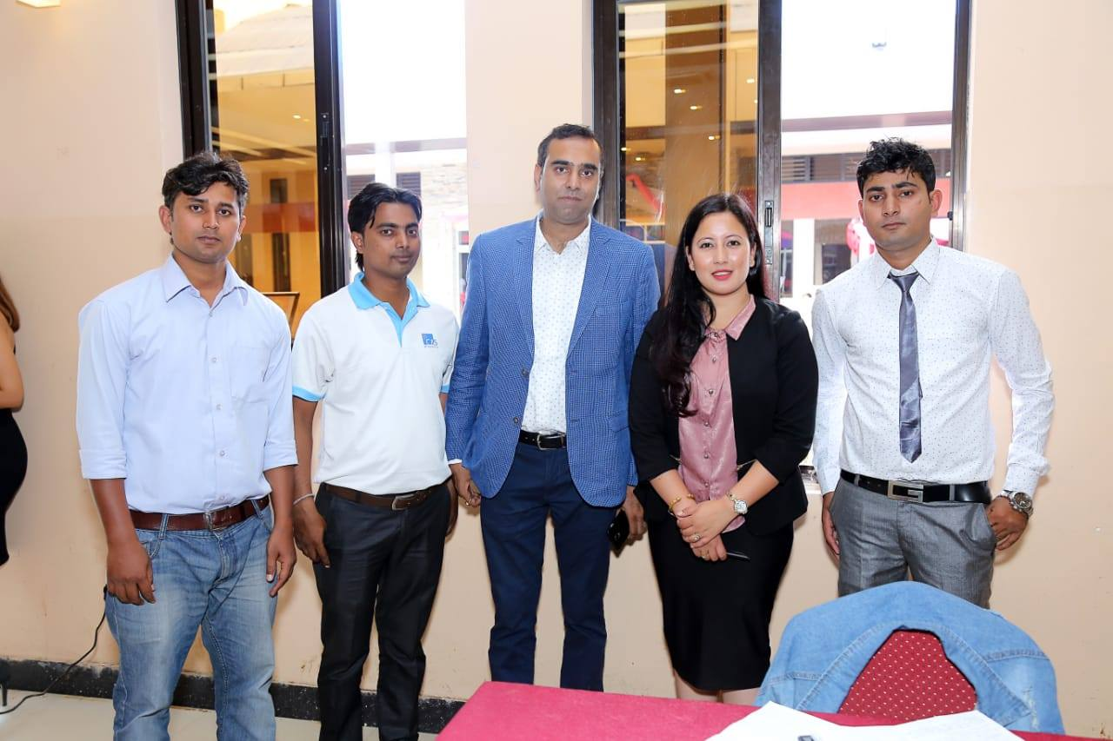
ANNAPURNA CABLE MEET
GIFT DITRIBUTION- GAIGHAT
DEALER MEET - BHAKTAPUR

Slide 12
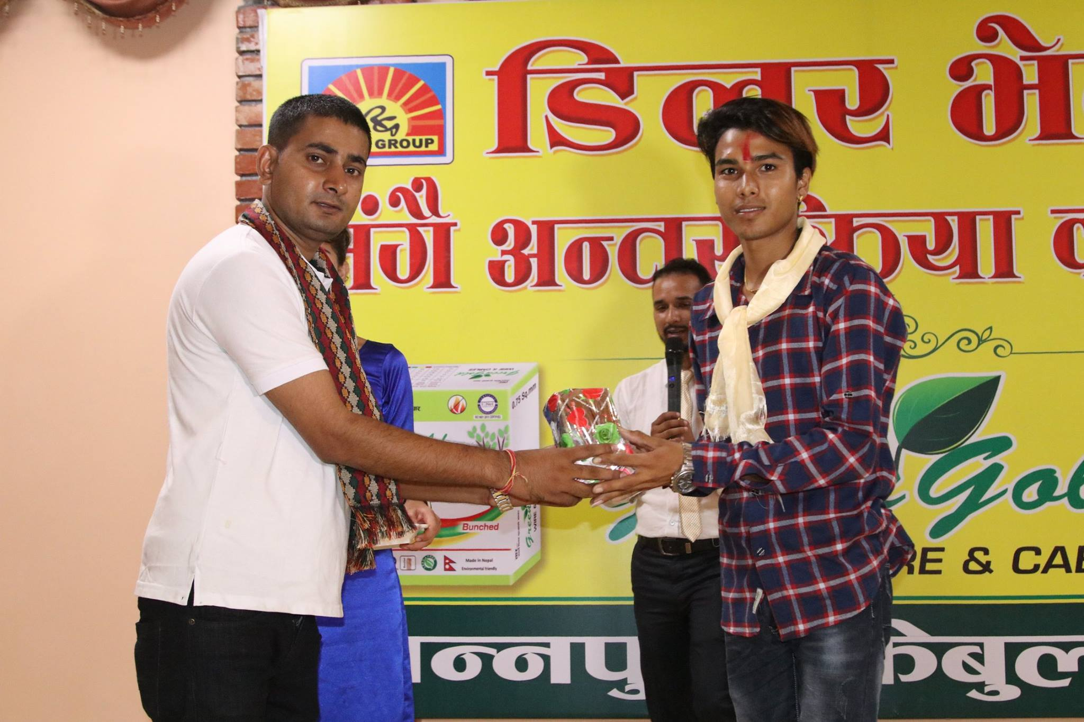
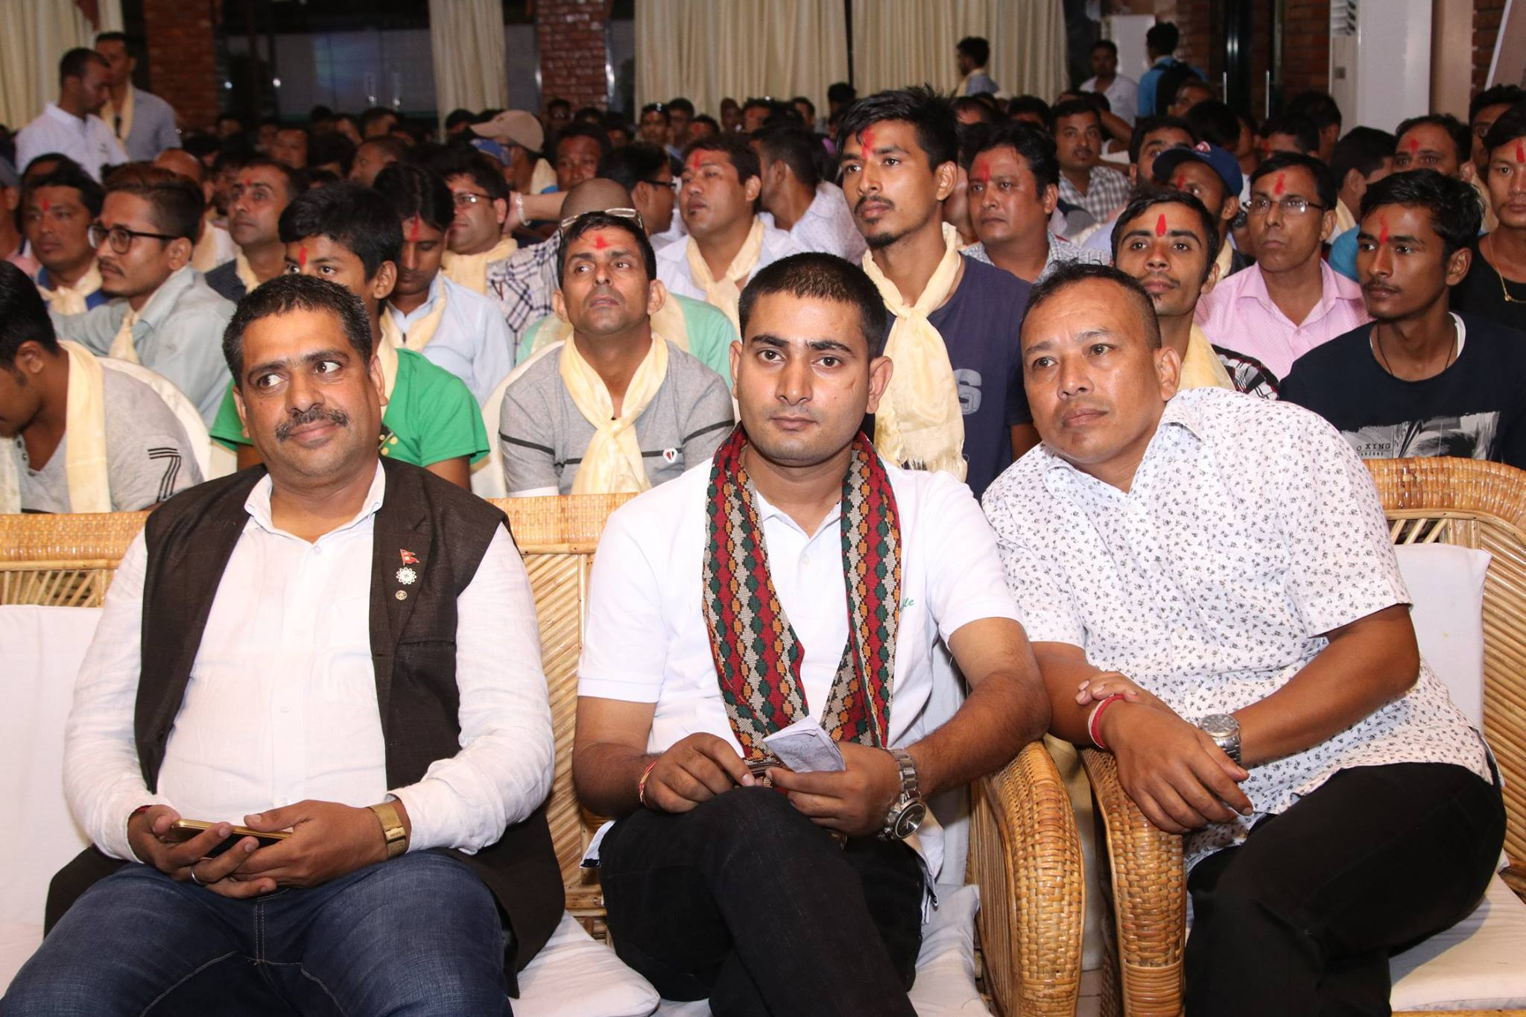
ANNAPURNA CABLE BUTWAL PROGRAM
GIFT DISTRIBUTION
DEALER MEET

Slide 13
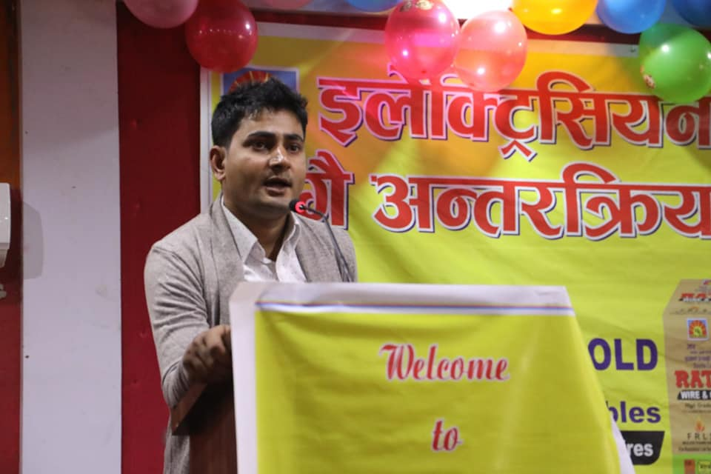
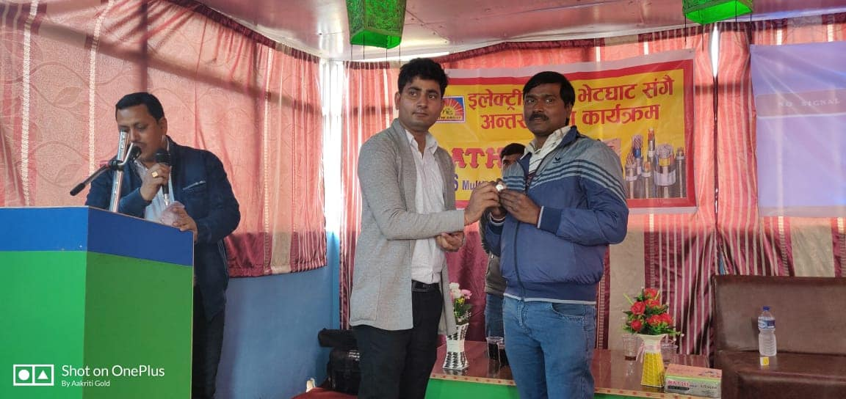
ANNAPURNA ELECTRICIAN MEET
CHAPUR ELECTRICIAN MEET
ITAHARI ELECTRICIAN MEET

